Slide 1

Bangalore Rapido Ride Services Dataset

Slide 2
services
date
time
ride_status
source
destination
duration
ride_id
distance
ride_charge
misc_charge
total_fare
payment_method

Slide 3
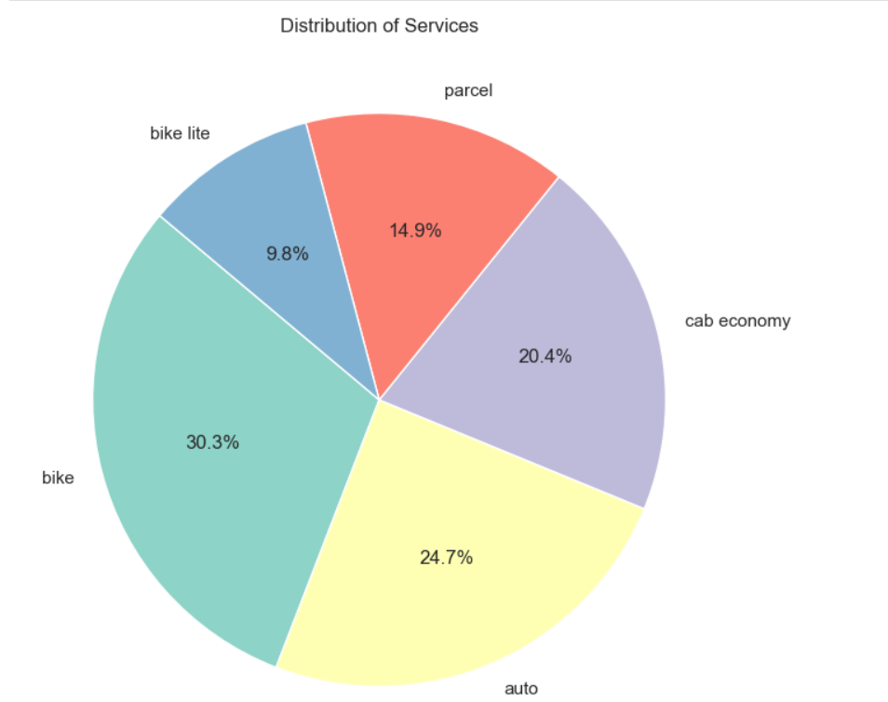
Distribution for services

Slide 4
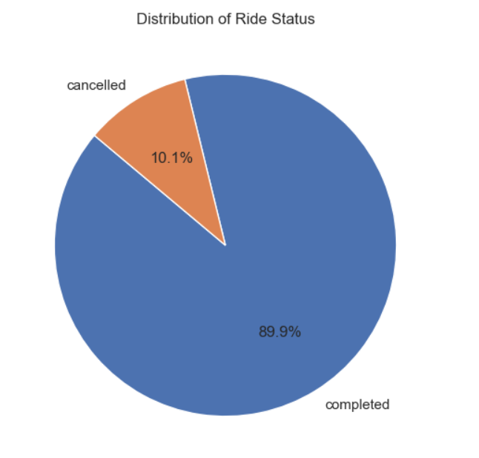
Distribution of ride status???
whaether completed or
cancelled?

Slide 5

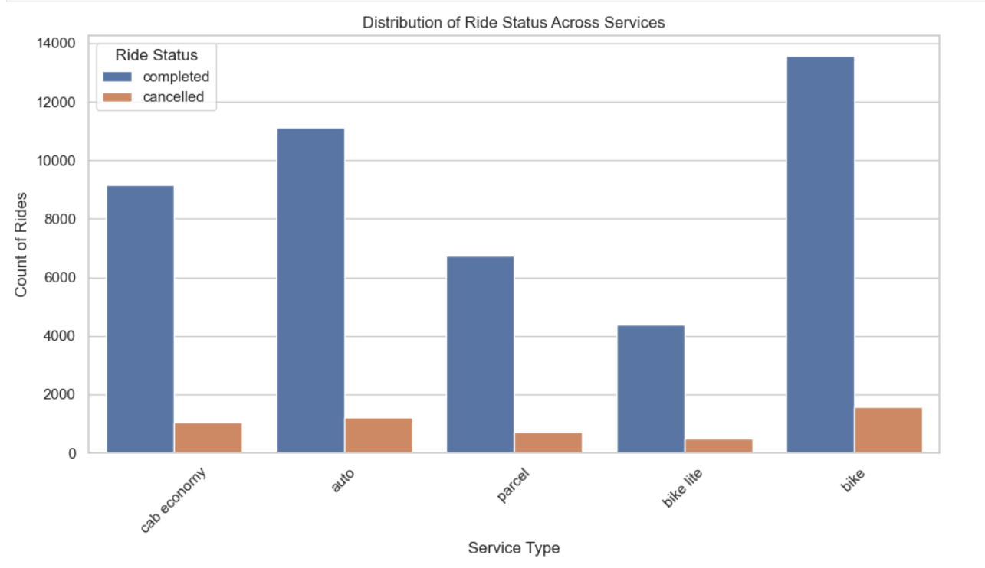
count of services

Slide 6
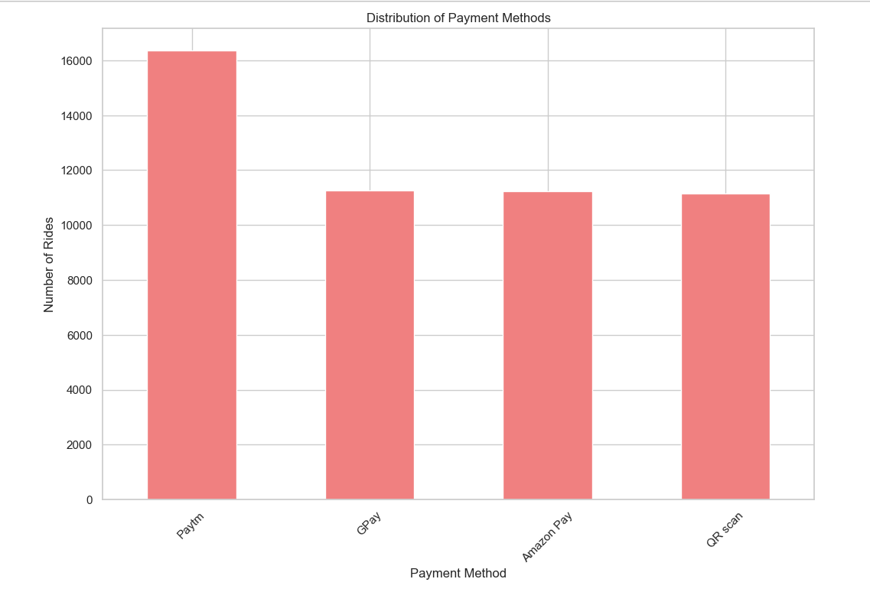

payment methods

Slide 7
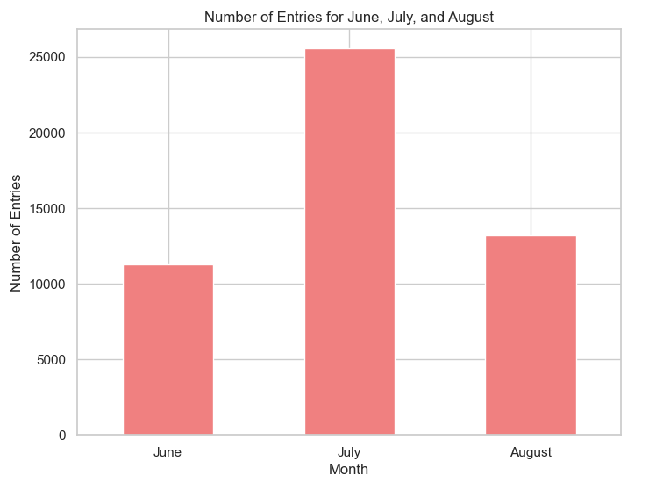
No of oders

Slide 8
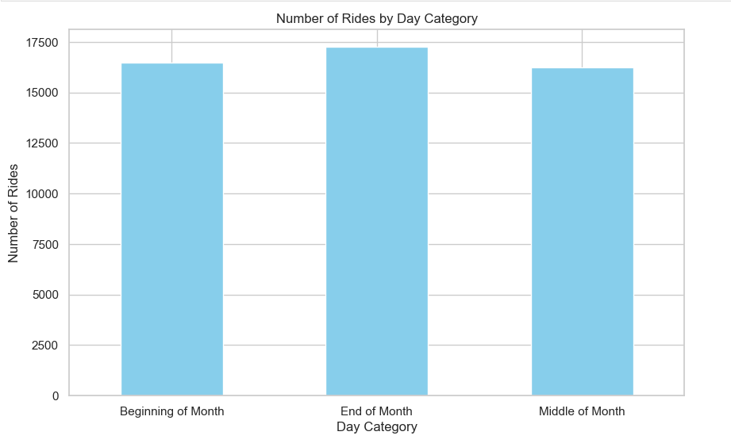
no of rides by week

Slide 9
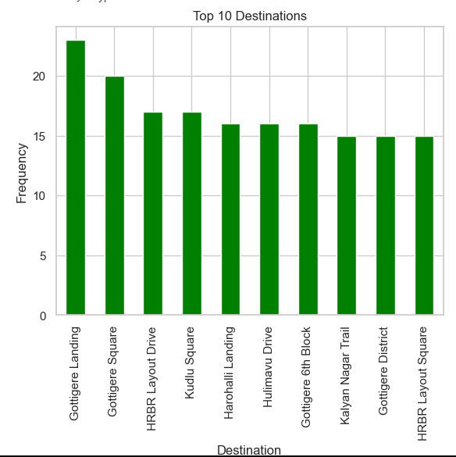
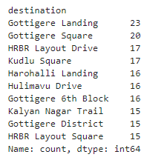
Top 10 destination

Slide 10
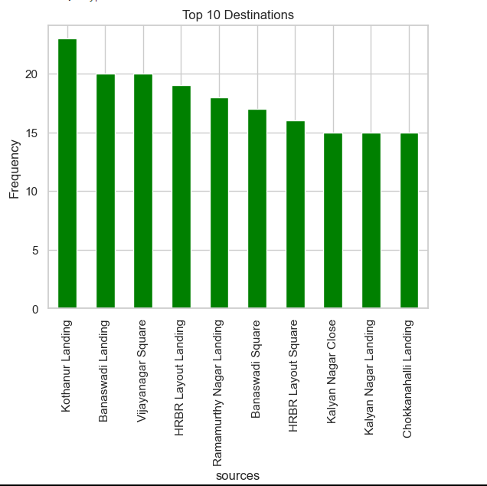
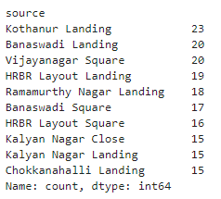
top 10 by source

Slide 11
STATISTICAL TESTING

Slide 12
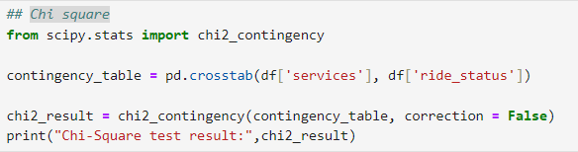
Chi square testing
statistic=4.8248564271951695
pvalue=0.305744929116748
Fail to reject the null hypothesis at alpha = 0.05.

Slide 13
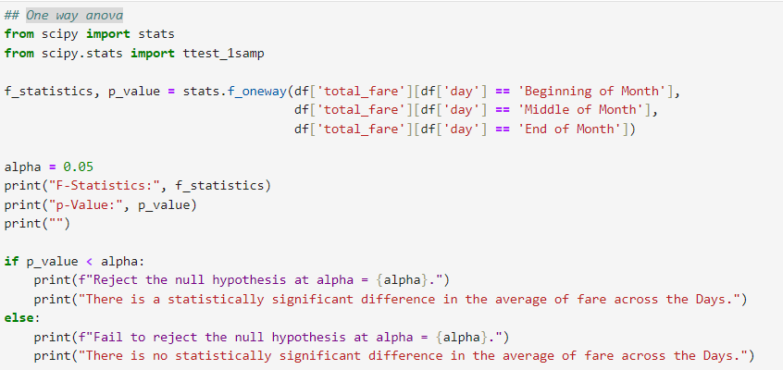
One way anova
F-Statistics: 0.6295625309485232
p-Value: 0.532829068291262
Fail to reject the null hypothesis at alpha = 0.05
There is no statistically significant difference in the average of fare across the Days

Slide 14
any queries

